Slide 1
TPF-5 (443) Dps user group meeting
November 10, 2021
Notes:
Welcome and intro

Slide 2
2021 Ohio DOT
DPS updates
Craig E. Landefeld, P.E.
ODOT Office of Pavement Engineering

Slide 3
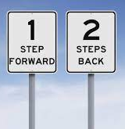

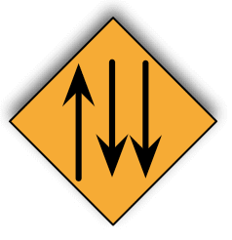
2021 – 1 step forward - 2 steps back
COVID Issues
Staffing Issues
Contractor Issues

Slide 4
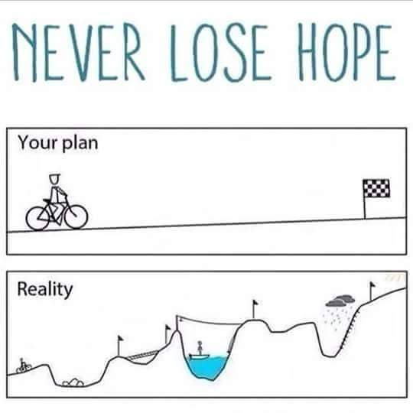
2021 Collection Procedures
Air/Metal Calibration Daily
AM/PM Line Test
Swerve collection pattern
Acceptance Core Collection
Lab Gyratory Samples
Long Joint Collection
  Single
  Straddle

Slide 5
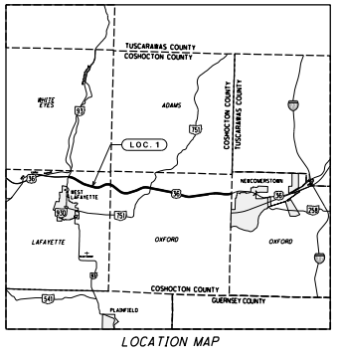
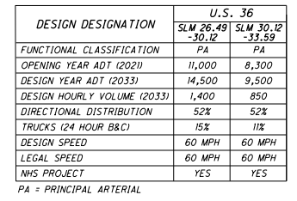
COS-US36 Project details
7mi. Rural 4–Lane Divided
1.5in -12.5mm Int.
1.5in -12.5mm Surface
Hot joint on shoulders
Cold joint at lane line
447 Joint Density Spec
Contractor Gyratories???

Slide 6
Repeat Line Tests
Notes:
The tolerance we discussed in the past was 0.08. I think the default on the RDM may be 0.1

Slide 7
COS-36 Core Calibrations

Slide 8
COS-36 Core Calibrations

Slide 9
COS-36 Longitudinal joint scans
Notes:
- Two different runs on the joint
- Single sensor on the joint
- Straddling the joint with two sensors
- Took average of two sensors for comparison on left

Slide 10
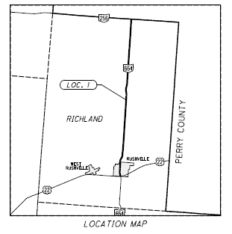
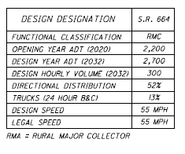
FAI-664 project details
5mi. Rural 2-lane
1.0in
1.25in. Surface Course
Control Section
  Type 1 Surface, PG 70-22M, 20% RAP
High RAP
  Balanced Mix Design
  Type 1 Surface, PG 70-22 w. recycling agent, 55-60% RAP
Notes:
The control section is planned to start production tomorrow morning around 10 AM (they still need to finish some intermediate mix). This mix is a Type 1 Surface with PG 70-22M with 20% RAP being produced out of the Shelly Co.’s Lancaster plant. Should be the northbound lane.
The high RAP/Balanced Mix Design mix is planned to start Friday, weather permitting, and end Saturday. This mix is also a Type 1 Surface but the final grade is to grade out as a PG 70-22 and include a recycling agent. The mix will have 55-60% RAP in it. There is a minimum of a 120 CT Index and a max of 12.5 mm on the Hamburg after 10,000 cycles (see attached plans, sheet 5 for more info).

Slide 11
Repeat Line Tests
Notes:
The tolerance we discussed in the past was 0.08. I think the default on the RDM may be 0.1

Slide 12
FAI-664 Core Calibrations Control section
Notes:
The calibration curve was taken in TIME mode
Used Unit 2 for these next two slides as that was the unit that was operated for both mixes

Slide 13
FAI-664 Core Calibrations high rap section
Notes:
The calibration curve was taken in TIME mode
Notice the scales on the frequency graph, the high rap is more variable (standard dev of control was about 0.12, high rap about 0.21)

Slide 14
Machine Comparisons
MAD-70 | M1 | M2
Mean | 6.26 | 6.11
Std Dev | 0.298 | 0.299
COS-36 | M1 | M2
Mean | 5.36 | 5.33
Std Dev | 0.247 | 0.253
FAI-664 | M1 | M2
Mean | 5.05 | 5.03
Std Dev | 0.121 | 0.124
Notes:
Now the question becomes what are good comparison methods??

Slide 15

Things to consider???
Causes of sensor variability?
Causes of poor core calibrations?
How do we define “comparison”
Is the effect of joint enrichment an issue?
Could we use this as a tool to assess Void Reducing Asphalt Membrane (VRAM)?
Notes:
Copy from April presentation

Slide 16
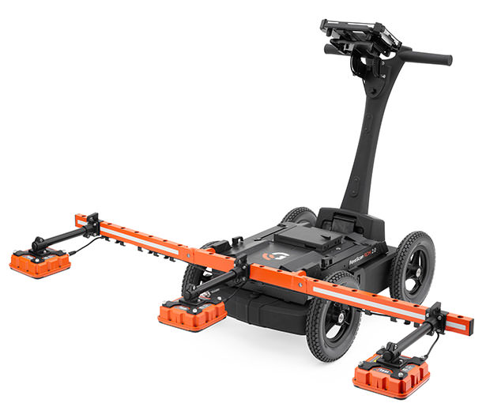
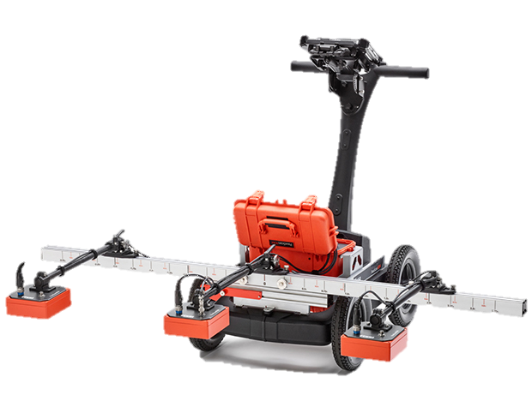
What’s next ???
Machine Comparisons
– Precision & Bias
- QC/QA Procedure & Comparison Tolerances
2. Gyratory Procedures
    - Work with Producers
3. Collection Procedures (Swerve? Long. Joints?)
    - Swerve / Linear
    - Longitudinal Joints
4. VETA Analysis
    - 2022 Projects
5. Specs for Pilot/Shadow Projects
Notes:
Copy from April presentation

Slide 17
Questions
?
Last updated 12/9/2021

